Slide 1




Targeted Delivery of ‘AAV5’-β-GDNF for
Motor Neuron Disease (MND/ALS)
Parkinson’s Disease (PD)
Spinal Cord Injury (SCI)
Non-confidential Investment Memorandum​
One proprietary gene therapy platform, Three life-changing treatments

Slide 2



Innervate Therapeutics Snapshot:
Innervate Therapeutics Ltd (ITL) is focused on the targeted delivery of GDNF to treat Motor Neuron Disease (MND), Spinal Cord Injury (SCI) and Parkinson’s Disease (PD)
  GDNF restores damaged neurons in pre-clinical models of MND & SCI, and has been shown clinically to be neurorestorative in PD. ITL is harnessing GDNF’s restorative properties using a proprietary gene therapy delivery technology and a superior proprietary β−GDNF isoform
  ITL has worldwide exclusive licenses to both the CNS delivery technology and the β−GDNF isoform.
  ITL’s distinguished leadership team includes Prof Steven Gill, who has pioneered innovative delivery technologies and therapies to the CNS
  This unique combination of a delivery technology and β−GDNF represents the company’s Gene Therapy Platform, which singularly can target numerous CNS based disorders, all with significant unmet medical needs and large untapped markets. The company already has a MHRA approved pathway to FIM clinical trials for MND by 2027.
ITL represents a highly valuable multi-billion $ opportunity

Slide 3



Executive Summary
Clear path to a positive return
Rapid MHRA approved development pathway to first-in-man study
Unmet clinical need representing multi-billion $ dollar market opportunity
Two ‘fast-track’ Orphan status indications offering early and extended market exclusivity
Post a successful FIM study, clear valuation uplift and attractive early acquisition target for big Pharma
Single proprietary GDNF gene therapy platform
For THREE neurological conditions with significant unmet clinical need:
Motor Neuron Disease (MND), Spinal Cord Injury (SCI) and Parkinson’s Disease(PD)
Minimised risk
GDNF protein proven to be safe in multiple clinical trials
Positive MHRA pre-clinical & clinical reviews completed
Successful CMC (production) feasibility study completed
Safe delivery gene platform minimises risk and cost.
World renowned team
Prof Steven Gill (CSO)
Prof. Neil Barua (CMO)
Prof. Mart Saarma
Prof. Kevin Talbot
Prof. Martin Turner
Strong IP protection
Worldwide exclusive licence agreed for use of novel patented GDNF isoform
Worldwide exclusive license agreed for proprietary gene therapy platform technology and enabling know-how
Seeking to raise £21 million at a proposed pre-money valuation of £20 million

Slide 4

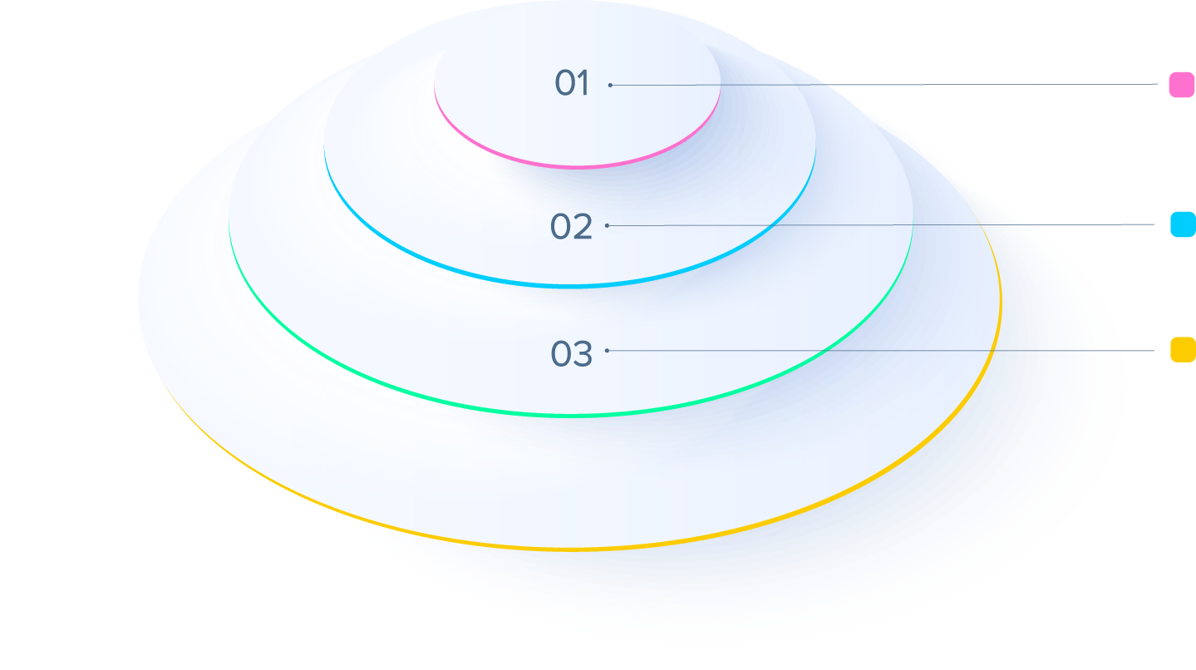
The Current Challenge
NO neurorestorative treatments for PD**
NO neurorestorative treatments for MND/ALS
NO neurorestorative treatments for SCI
These THREE diseases combined represent a multi-billion $ market and an unmet need for ≥ 12 million people worldwide
Our Proprietary Solution:
GDNF* is a small protein that protects and restores the function of a wide range of neurons and glia, and has been shown to be beneficial in the clinic for PD, and in pre-clinical studies for MND and SCI
ONE proprietary gene therapy platform, THREE life-changing treatments
*Glial Cell Derived Neurotrophic Factor
** Reference Askbio Clinical Trial

Slide 5



The Opportunity
Innervate Therapeutics Limited (ITL) is a pioneering UK based drug development company, focused on the targeted delivery of GDNF to treat Motor Neuron Disease(MND), Spinal Cord Injury(SCI), Parkinson’s Disease(PD) and other neurogenerative diseases related to PD
GDNF restores the function of damaged neurons in pre-clinical models of MND, SCI and PD. Clinically shown to be neurorestorative in phase II PD studies. ITL is now positioned to harness GDNF’s remarkable properties for the treatment of these diseases in patients using a proprietary and targeted gene therapy platform technology* and a superior GDNF isoform**
The company’s novel gene therapy to treat MND is in advanced pre-clinical development and a first-in-man study is planned for 2027. Pre-clinical development of the same gene therapy platform to treat SCI will commence on completion of funding, with the aim of initiating a first-in-man study for this indication in 2027 also. A third indication of the gene therapy platform to treat PD will enter pre-clinical development once funding is in place
ITL represents a highly valuable multi-billion $ opportunity to exploit a significant unmet clinical need in three neurodegenerative disease areas affecting ≥ 12 million people globally.
*Exclusive license agreement with Neurochase Ltd (subject to funding)
** Exclusive license agreement with Prof M. Saarma, University of Helsinki (subject to funding)

Slide 6
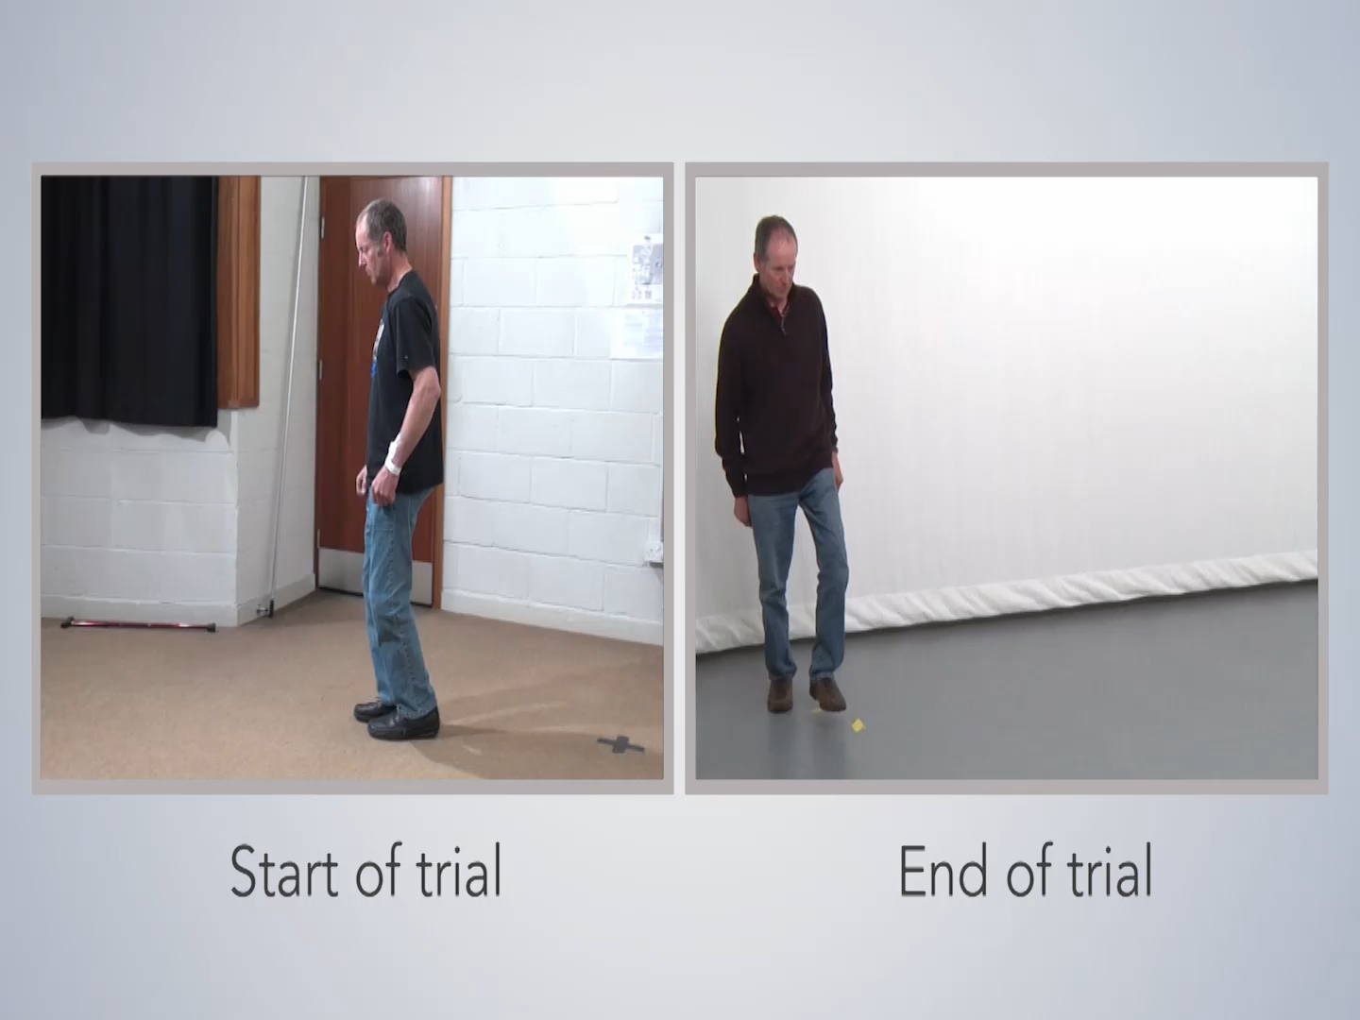
The Solution
The Clinical Benefit of GDNF is proven in PD patients
Videos below show some of the participants in the 2012 phase II study before and after infusions of GDNF protein therapy
Press PLAY here
*Glial cell line-Derived Neurotrophic Factor
**Convection Enhanced Delivery

Slide 7


Background and History of GDNF for Parkinson’s Disease
Convection Enhanced Delivery (CED) is a method of administering medicines directly into the brain. The delivery technology was developed and optimised by ITL’s Co-founder Prof. Gill, enabling the precise delivery of GDNF protein to the brain. This paved the way for a ground-breaking Parkinson’s Disease (PD) phase II clinical trial in 2017¹
This clinical trial demonstrated conclusively that precise delivery of GDNF protein had the potential to be neurorestorative and to halt and even reverse the progression of PD (as per previous videos)
However, GDNF protein therapy has challenges; patients required multiple re-administrations of GDNF, through a skull mounted port, increasing complexity, costs and risk
These challenges could be overcome by a CED-mediated GDNF gene therapy platform, which requires only a single infusion, substantially simplifying the process for all indications outlined
ITL is uniquely positioned to deliver this gene therapy platform
¹Journal of Parkinson’s Disease 9 (2019) 301–313 DOI 10.3233/JPD-191576​

Slide 8


Neurochase’s Game changing gene therapy delivery technology
Gene therapies for CNS diseases will only be effective if delivered directly to disease relevant targets
Neurochase have developed and patented the next generation of CNS delivery systems. The technology is highly effective, safe, scalable and poised to revolutionise CNS gene therapy delivery. Leading biotech companies have licensed this technology and know-how (IP Protected delivery strategies) for their drug development programs. Approval for clinical use expected 2025.
ITL has been granted an exclusive global licence to use Neurochase’ platform technology, delivery methods IP and know-how for GDNF gene therapy administration for all CNS indications.
Access to this novel technology provides ITL with a key competitive advantage over all other GDNF gene therapies.
The Neurochase licence agreement includes an access fee of £500,000, payable in four equal quarterly tranches post completion of funding, an annual license fee of £50,000 and a royalty on net sales of 0.75%. The agreement makes provision for the supply of delivery devices at discounted prices.

Slide 9
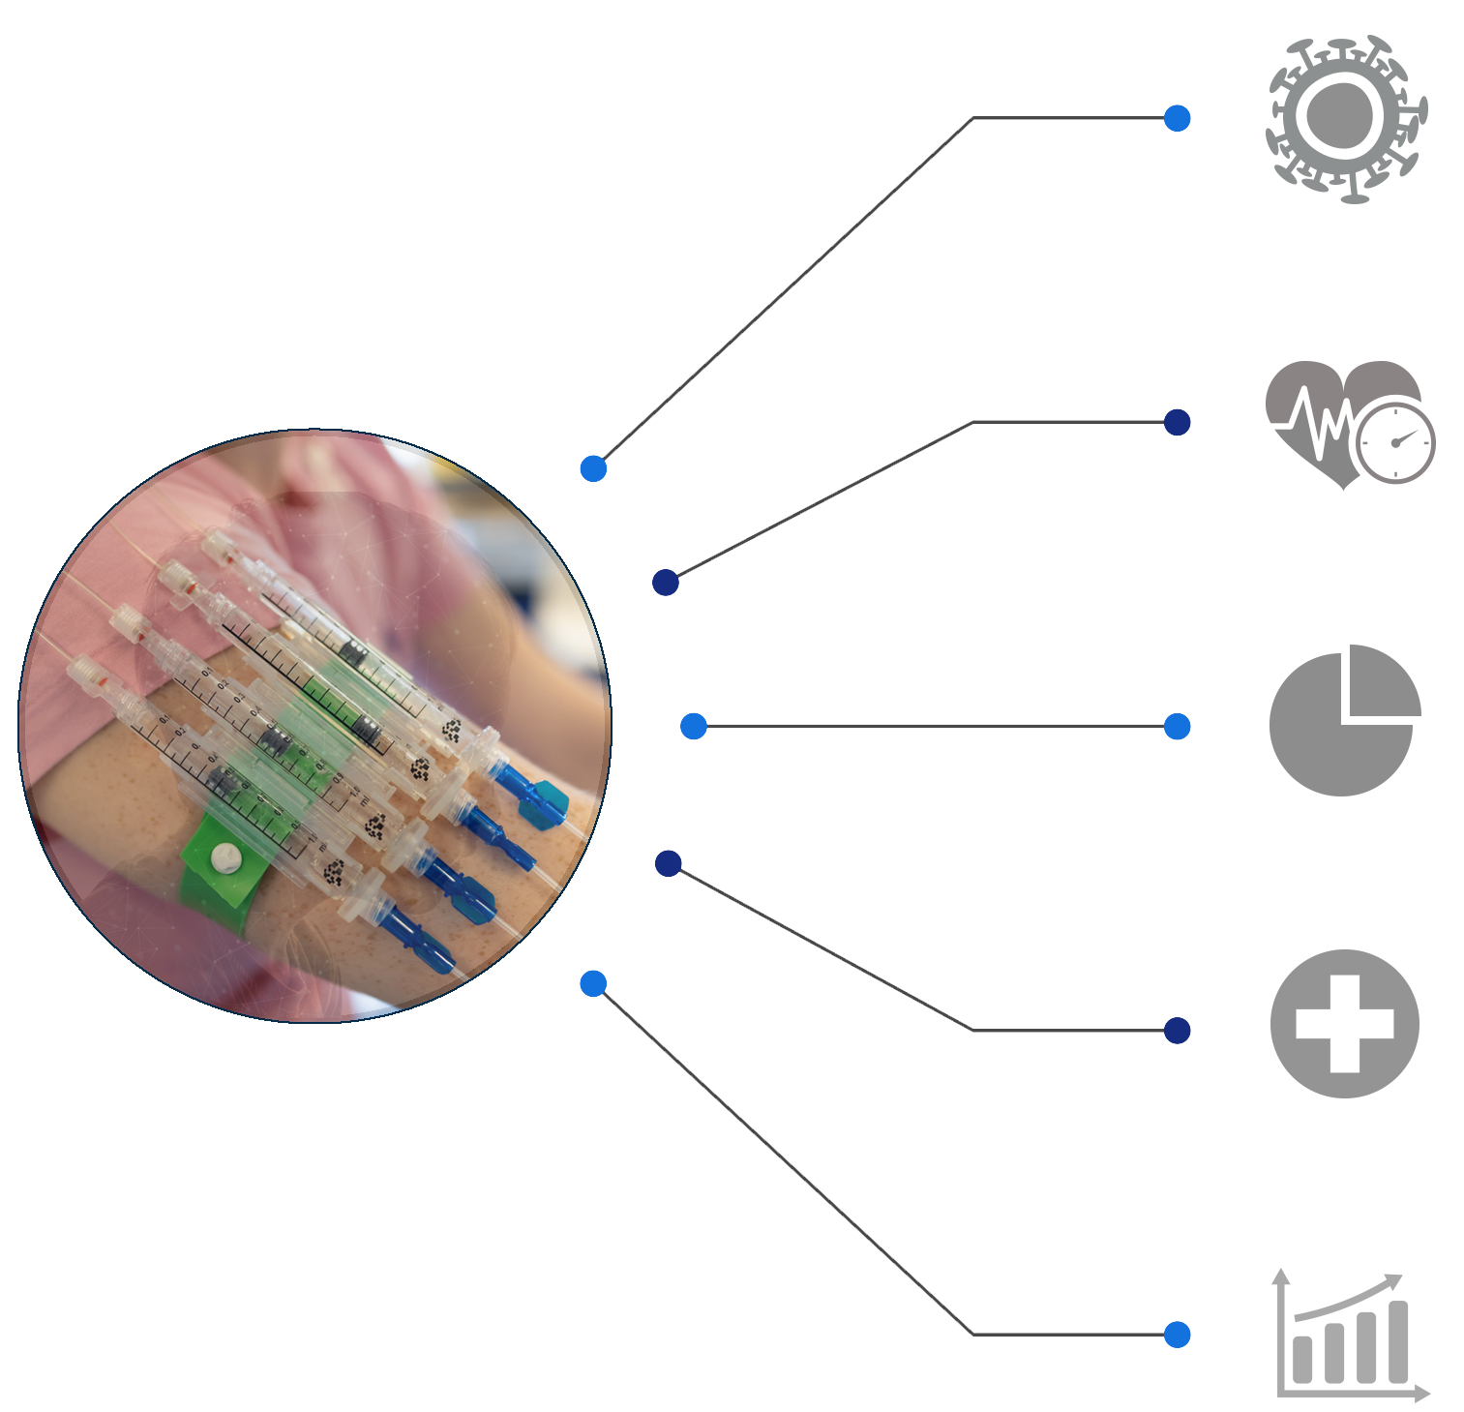

Neurochase’s CNS Delivery Technology advantage
The success of any GDNF therapy is dependent on safe accurate and direct delivery to disease-relevant targets within the brain
The Neurochase Acute Delivery System is
EFFECTIVE & ACCURATE
Bypasses the Blood Brain Barrier and delivers
to precise locations in the brain, massively increasing
the likelihood of success.
FAST
The system should allow for significantly reduced operating times
SIMPLE
Surgeons can concentrate on the surgery with all measurements planned and prepared in advance. The Infusion is plug & play outside of theatre. MRI not required during surgery
SAFE
Reduces chances of human error, trauma, infection, cannula displacement, chance of wrong dosing, exposure to biohazardous therapy. Patient monitored during infusions whilst awake (only local anesthesia required)
SCALEABLE
Simplified workflow. Surgical expertise not required. Short theatre time. Short infusion time. Cost effective & requires a fraction of the drug compared to systemic delivery
Neurochase Ltd are developing the next generation of CNS delivery systems, with a focus on safety, simplicity and scalability. The device is expected to be CE marked and approved for clinical use by Q2 2025.
ITL has an exclusive worldwide licence for the Neurochase drug delivery system

Slide 10
β-GDNF isoform
ITL’s GDNF gene therapy is protected by Composition of Matter IP. The β isoform is unique in that its release is naturally regulated. This offers significant advantages over other gene therapies
ITL has an exclusive Option to license this patented isoform of hGDNF from Prof. Mart Saarma at University of Helsinki.
Prof. Saarma is the world expert on GDNF, having fully characterised these novel GDNF isoforms and elucidated their mechanism of release. The β isoform is physiologically released in response to neurons firing, promoting the health of neurons and glia and preventing downregulation from chronic receptor stimulation. This unique isoform will provide a significant clinical and competitive advantage.
On completion of the present funding round, ITL will exercise its Option to have ownership of the β-GDNF cDNA gene sequence assigned to it for a one-off Option fee of £230,000 and a 0.75% royalty on net sales payable to Prof. Saarma. This will give the company complete control over the key asset that will be used in all of its gene therapy products.

Slide 11
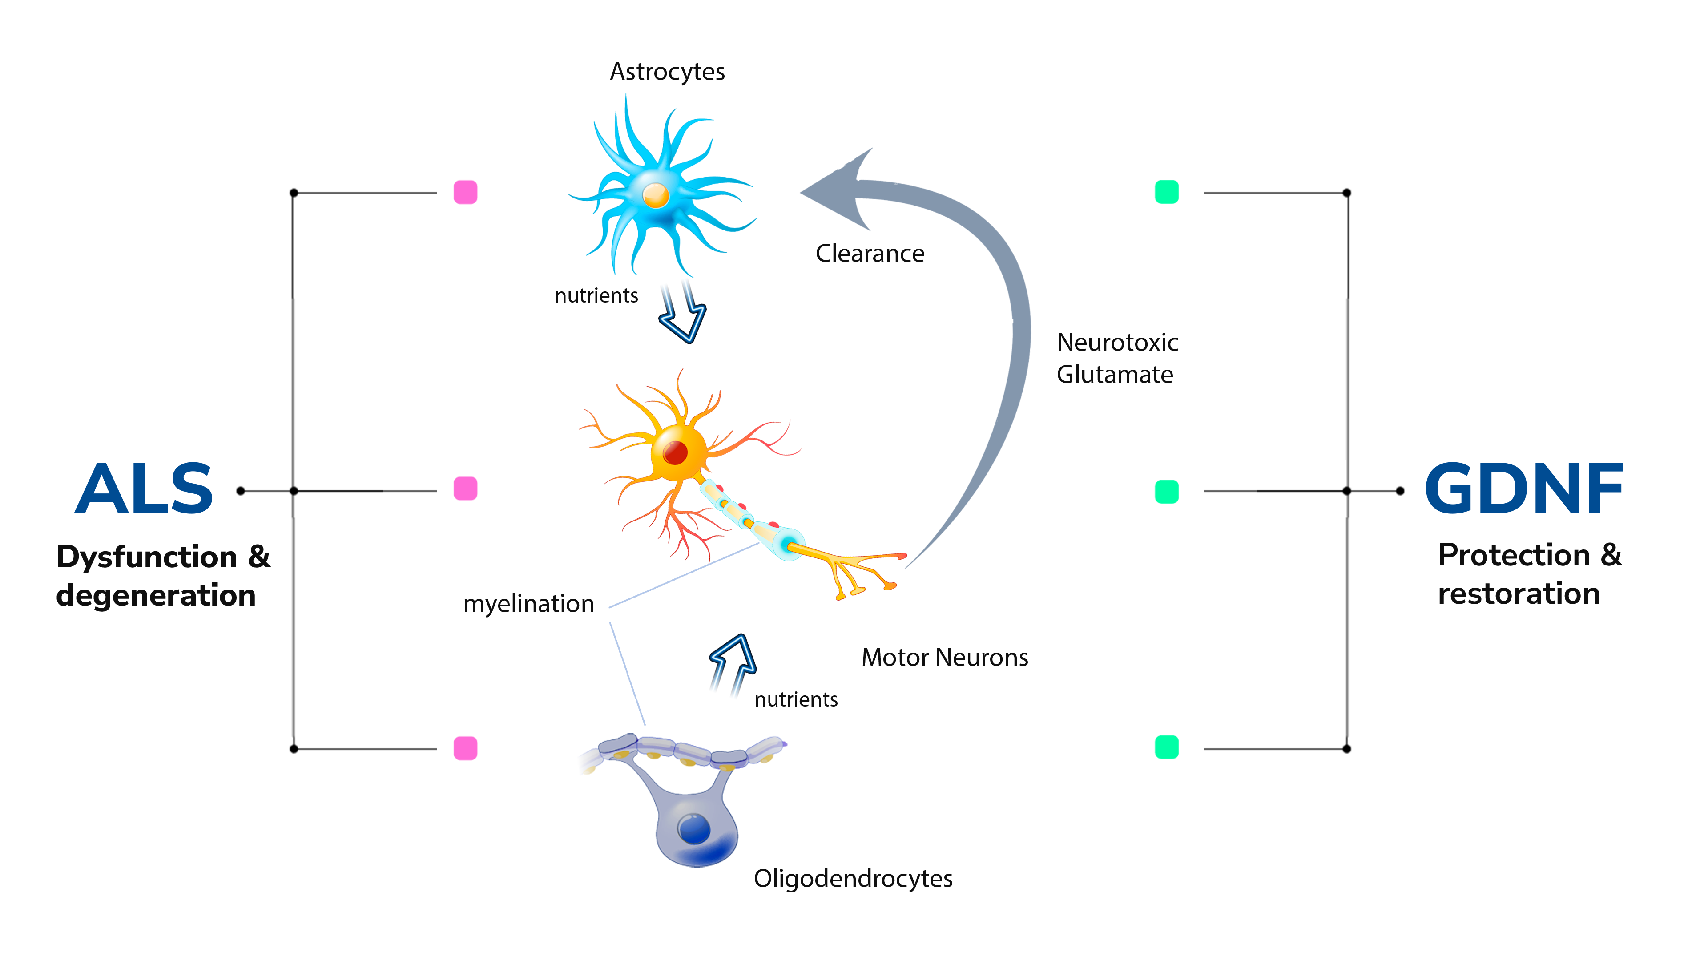
Effects of GDNF in MND/ALS
GDNF protects and restores the function of the neurons and supporting cells which degenerate in MND/ALS
INN MND 001

Slide 12
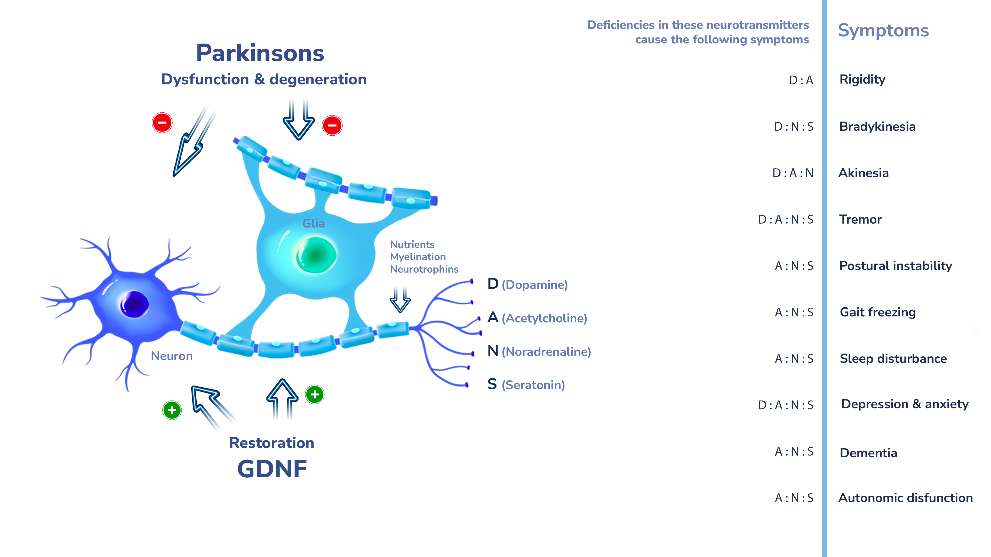
Effects of GDNF in Parkinson’s Disease (PD)
INN PD 001

Slide 13
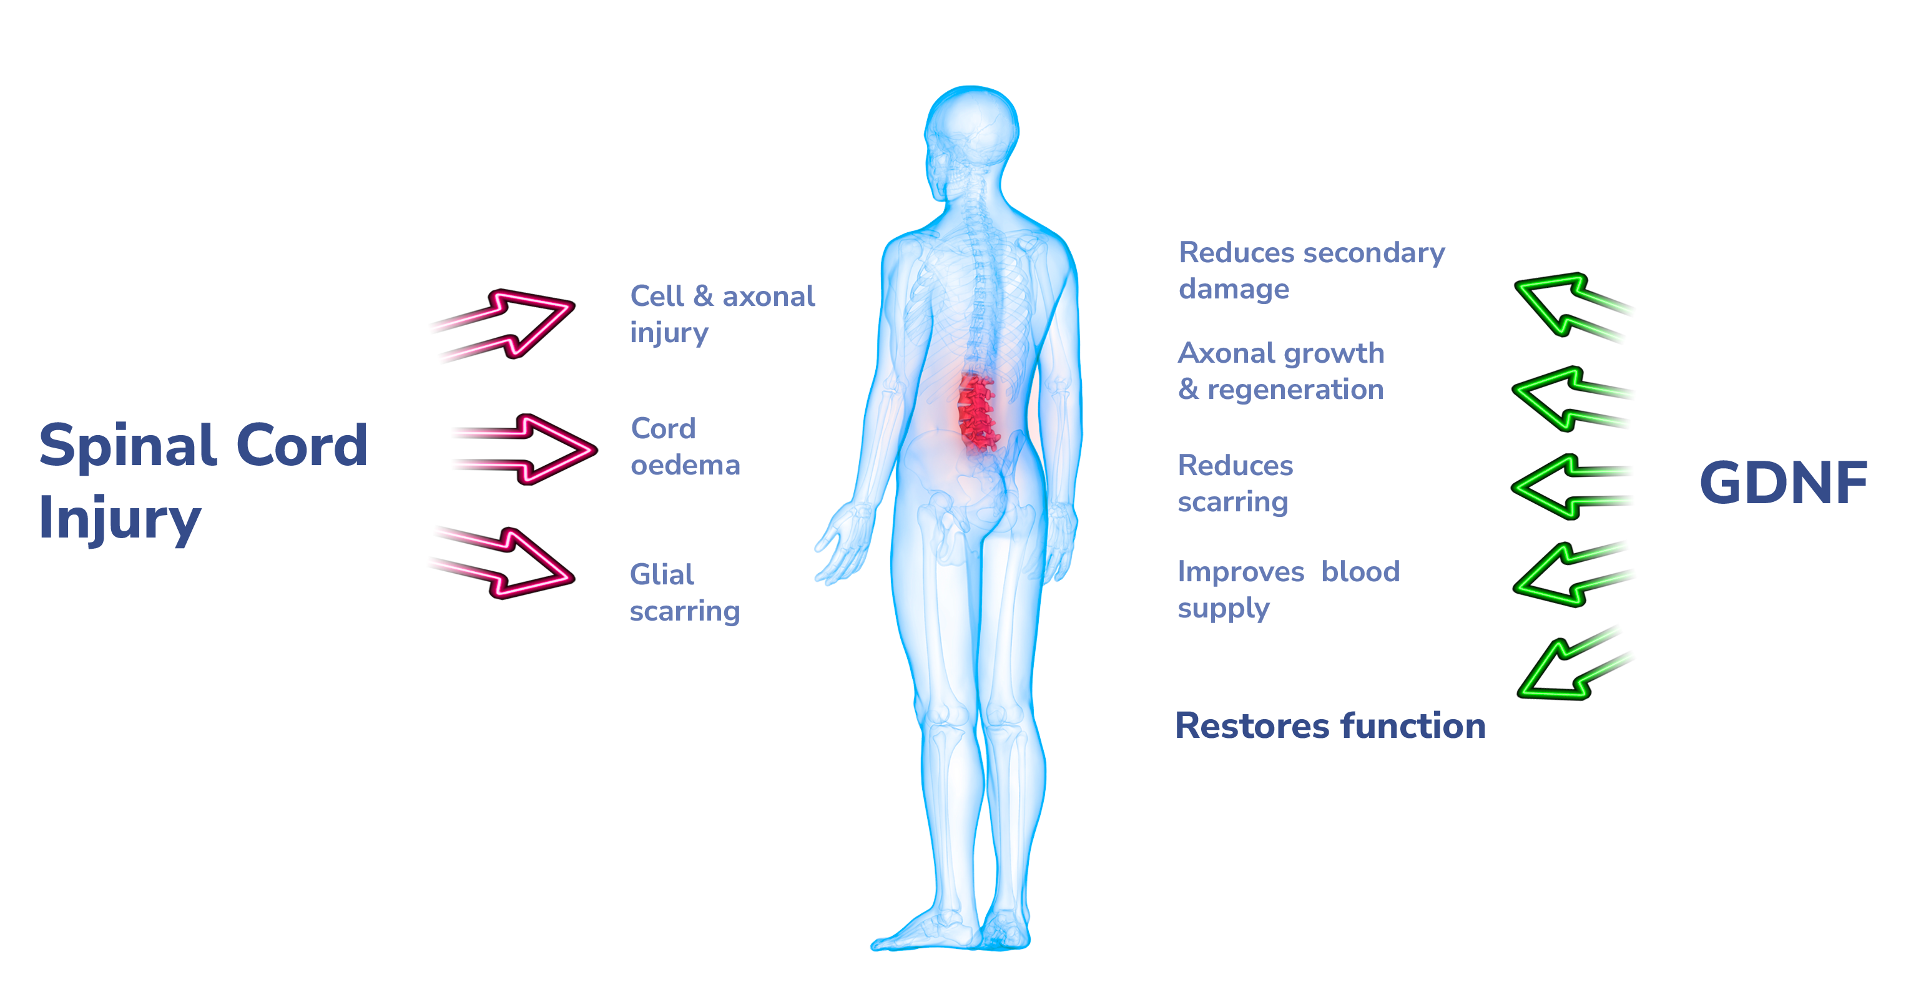
Effects of GDNF in Spinal Cord Injury (SCI)
GDNF reduces secondary injury after SCI, promotes axonal growth and regeneration, increases blood supply and reduces the size of the spinal cord lesion resulting in functional recovery
INN SCI 001

Slide 14
Commercial Objectives & Strategy
ITL is developing an innovative and proprietary gene therapy platform to initially treat three chronic, progressive and debilitating CNS-based disorders of MND, SCI and PD.
ITL’s three target indications have significant unmet clinical need. The most advanced therapy for MND is very close to the clinic, with a first-in-man (FIM) study targeted for 2027. A successful FIM study will result in a significant value uplift for ITL and a possible exit point.
ITL’s proprietary gene therapy delivery platform and GDNF isoform represents a unique near-to-clinic asset that will attract alliances and/or co-development agreements with Pharma. ITL will actively seek such agreements to ensure that these life-changing treatments reach patients as quickly as possible.
MND and SCI represent rare diseases, currently with no restorative treatments. ITL aims to secure regulatory orphan drug designation and first-tracking of these indications through the clinic. Market approval is possible after a successful phase 2 trial. Thus, enabling a possible ‘first to market’ dominant position. Such is the need for an effective treatment for MND, conditional market approval in limited patients is possible on completion of first-in-man studies.
ITL, will constantly aim to secure non-dilutive capital funding and grants that align with the company’s strategy. Thereby reducing costs and expanding academic and commercial networks with similar minded parties, to get these products into patients
On completion of the treatment phase of first-in-man studies (2027), ITL will be able to attract commercial partners willing to purchase an Option (for a premium fee of ≥ £20m per indication) to license either MND/SCI indications and possibly to co-fund further phase 1b/2 clinical development.

Slide 15

Valuation
ITL is now embarking on a funding round of £21 million, to fund the next stage of the company’s development, as we drive these product into clinical stage assessment. To date the company has self-funded all the development work from founder shareholders with grant assistance from major MND charities.
This funding is sought at a pre-money valuation of £20M. This valuation is based on an approved route and ‘closeness’ to the clinic, the low risk profile provided from a single proprietary gene therapy platform to treat three major disease areas, with large unmet need and market ‘exclusivity’. Additionally, there is significant embedded value in the combination of the delivery system and the β GDNF isoform.
ITL benefits from a very experienced senior leadership team in the gene therapy sphere. ITL’s senior management are world leaders in the use of CED with a proprietary gene therapy technology which now promises to unlock the potential of gene therapies worldwide in multiple indications.
In summary, the investment made to date, the combined Intellectual Property bundle, together with the proven scientific expertise and knowledge of the founders, and approved clinical trial protocols and FIM studies, forms the basis for this pre-money valuation.

Slide 16


Use of Funds
The £21M funding sought will finance the rapid development of ITL’s gene therapy pipeline as follows:
£12M to complete CMC development (full cost) to establish a commercial scale production and remaining pre-clinical development tasks for the MND and SCI indications targeted for 4Q/26 and 1Q/27 respectively
£5M to complete first-in-man studies for MND and SCI indications targeted for 4Q/27 for both indications (excluding mandatory patient follow up)
£3M to complete pre-clinical development for the PD indication targeted for 3Q/28
£1M for License fees and G&A purposes.
Note that all staff salaries are included in the above costs

Slide 17
Disclaimer
This document has been prepared for information purposes only in connection with a possible investment in ITL Therapeutics Limited (“the Company”). The information in this document or on which this document is based has been obtained from sources that the Company believes to be reliable and accurate, but it has not been independently verified. The information and opinions contained in this document are provided as at the date of this document and are subject to change without notice and without obligation for the Company to update the same. No representation or warranty, express or implied, is or will be made in relation to, and no responsibility of liability is or will be accepted by the Company or by any of its officers, servant or agents as to or in relation to, the fairness, accuracy or completeness of this document or any other written or oral information made available to any interested party in relation to such investment. The Company expressly disclaims any and all liability that may be based on such information, errors therein or omissions there from. In particular, no representation or warranty is given as to the attainment or reasonableness of any future projections, management targets, prospects or returns.
This document is confidential, it is not to be shared with any other person and has not been approved for the purposes of the Financial Services and Markets Act 2000 (“FSMA”) or otherwise. It is being distributed only to recipients who have indicated that they are persons to whom it may lawfully be issued without the need for it to be issued or approved by an authorised person for the purpose of section 21 of the FSMA, being persons having professional experience in matters relating to investments and persons who are investment professionals as specified in Article 19(5), Article 43, Article 48, Article 49, Article 50 and Article 50A of the Financial Services and Markets Act 2000 (Financial Promotion) Order 2005 (the “Order”), or any other person to whom these materials may lawfully be distributed as a result of the exemptions contained within the Order from the restriction contained in section 21(1) FSMA, or to anyone else other than someone to whom it would otherwise be lawful to do so.
These materials and the information contained herein shall not constitute or form part of an offer of transferable securities to the public in the United Kingdom. These materials do not constitute an offer to sell or the solicitation of an offer to purchase securities, nor shall it or any part of it or the fact of its distribution form the basis of, or be relied on in connection with, any contract therefore, nor shall there be any sale of securities in the Company, in any jurisdiction in which any offer, solicitation or sale would be unlawful prior to registration or qualification under the securities laws of any jurisdiction including, without limitation, the United States of America.
This document does not purport to contain all of the information that may be required or necessary to evaluate all of the factors that may be relevant in connection with an investment in the Company. Neither the Company nor any of its affiliates or representatives make any representation or warranty express or implied, as to the accuracy or completeness of the information contained herein. The Company and its affiliates and representatives expressly disclaim any liability arising in whole or in part, out of errors or omissions from the information contained herein.
Neither this document nor any copy of it may be taken or transmitted into any jurisdiction outside the United Kingdom. In particular, neither this document, nor any copy of it, may be taken, transmitted or distributed, directly or indirectly, into the United States of America, its territories or possessions or passed to US Persons (as defined in Regulation S of the United States Securities Act of 1933 (as amended)), United States residents, corporations or other entities. Distribution of this document in the United States may constitute a violation of United States securities law.
By accepting this Document, you agree to be bound by the foregoing limitations.
Date: November 2024

Slide 18



For Further Information Please Contact
Ashley Cooper – CEO ​
ashley.cooper@innervatetx.com ​
+44 (0)7775 782501
Keith Murdoch – CFO ​
keith.murdoch@innervatetx.com ​
+44 (0)7974 911514

